Slide 1
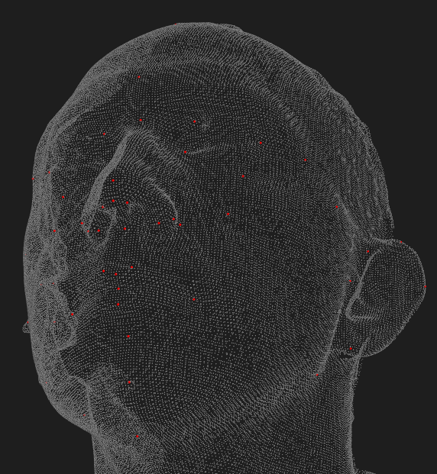

Deep Learning-Based 3D Facial Landmark Localization:
A Two-Step Approach with CNN and T-Net
Thesis of: Ali Shadman Yazdi (Matr. 991655)
9th April 2024
Supervisor: Prof. Giuseppe Baselli,
Dott.ssa. Annalisa Cappella
Co-supervisor: Ing. Benedetta Baldini
Academic year 2023/2024
Master of Science in Biomedical Engineering
School of Industrial and Information Engineering

Slide 2
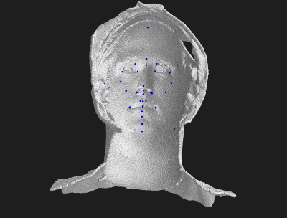
Objective of the Thesis
“To develop a supervised Deep learning model to localize 50 anatomical landmarks on 3D facial models acquired through stereophotogrammetry imaging system”
Why is it usefull?
3D anthropometric analysis
Early diagnoses of different pathologies, such as Marfan and Aicardi syndrome
Study facial changes from treatments like orthognathic surgery
Plastic surgery planning and evaluation
Facial asymmetry
Normal or abnormal growth patterns
Enhance the precision of superimposing two faces

Slide 3
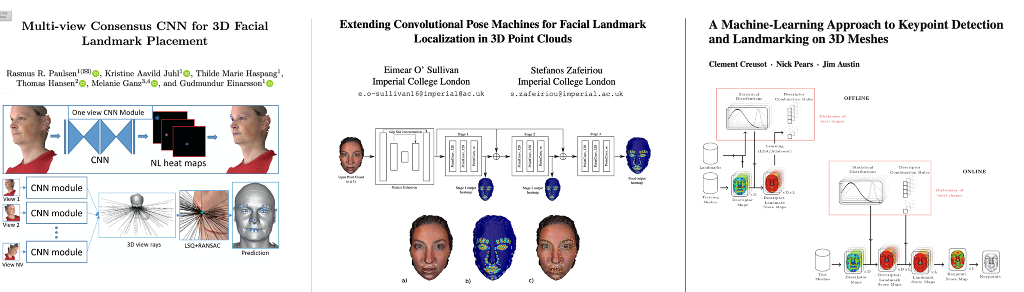

Previous Works
Predicted:
83 Landmarks
(BU-3DFE Dataset)
Predicted:
83 Landmarks
(BU-3DFE Dataset)
Predicted:
14 Landmarks
Localization accuracy:
~ 2.4 mm of error
Localization accuracy:
N/A
Localization accuracy:
~ 5.0 mm
Method:
Deep learning - (2D CNN)
Method:
Deep learning – PointNet
Method:
Machine learning

Slide 4
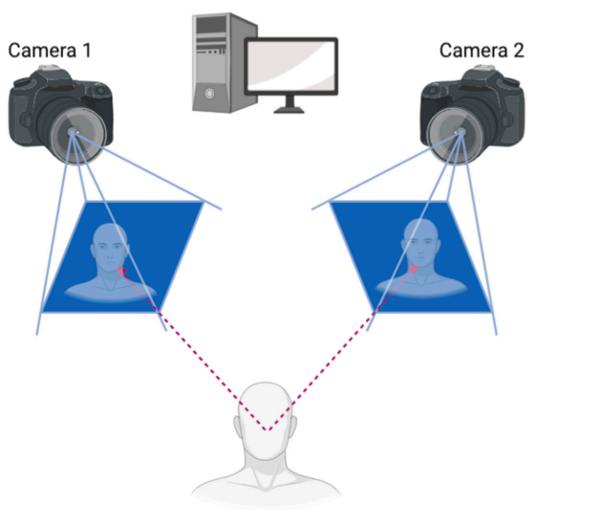
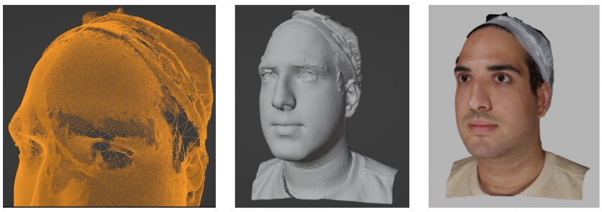
What are Stereophotogrammetry Acquired Images?
Stereophotogrammetry captures 3D data by analyzing multiple 2D images from different angles, mimicking human depth perception.
Pros:
Accurate Reproduction
Quick Acquisition
Non-Invasive
Facial Texture Capture
Cons:
Instrument Calibration
Post-Processing Time
Cost
Artifacts

Slide 5
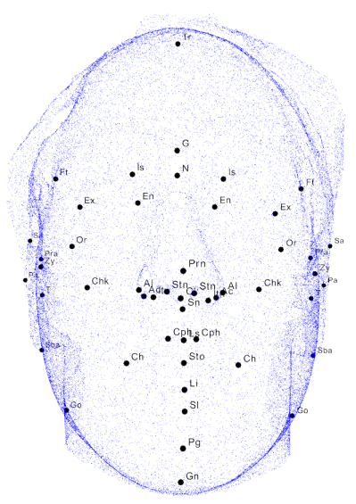
Our Dataset
200 stereophotographs with annotated facial landmarks:
Input data (200, n, m) (OBJ file)
Maximum of ~200,000 point (vertexes)
3 value for each point (XYZ coordinates)
3 value for vector normals (nx,ny,nz)
2-3 jpeg images per face
n = number of points in the point cloud
m = number of features for each point in the point cloud
Target data: (200, 50, 3) (Txt file)
20 facial models
50 landmarks
3 value for each point (XYZ coordinates)

Slide 6
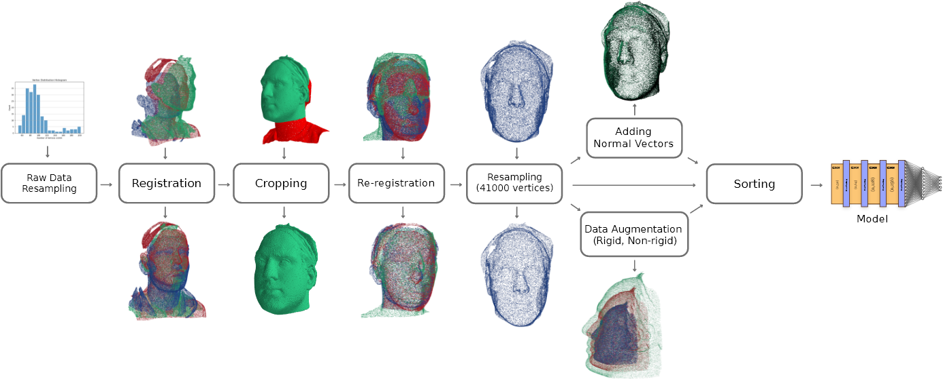
Preprocessing pipeline

Slide 7
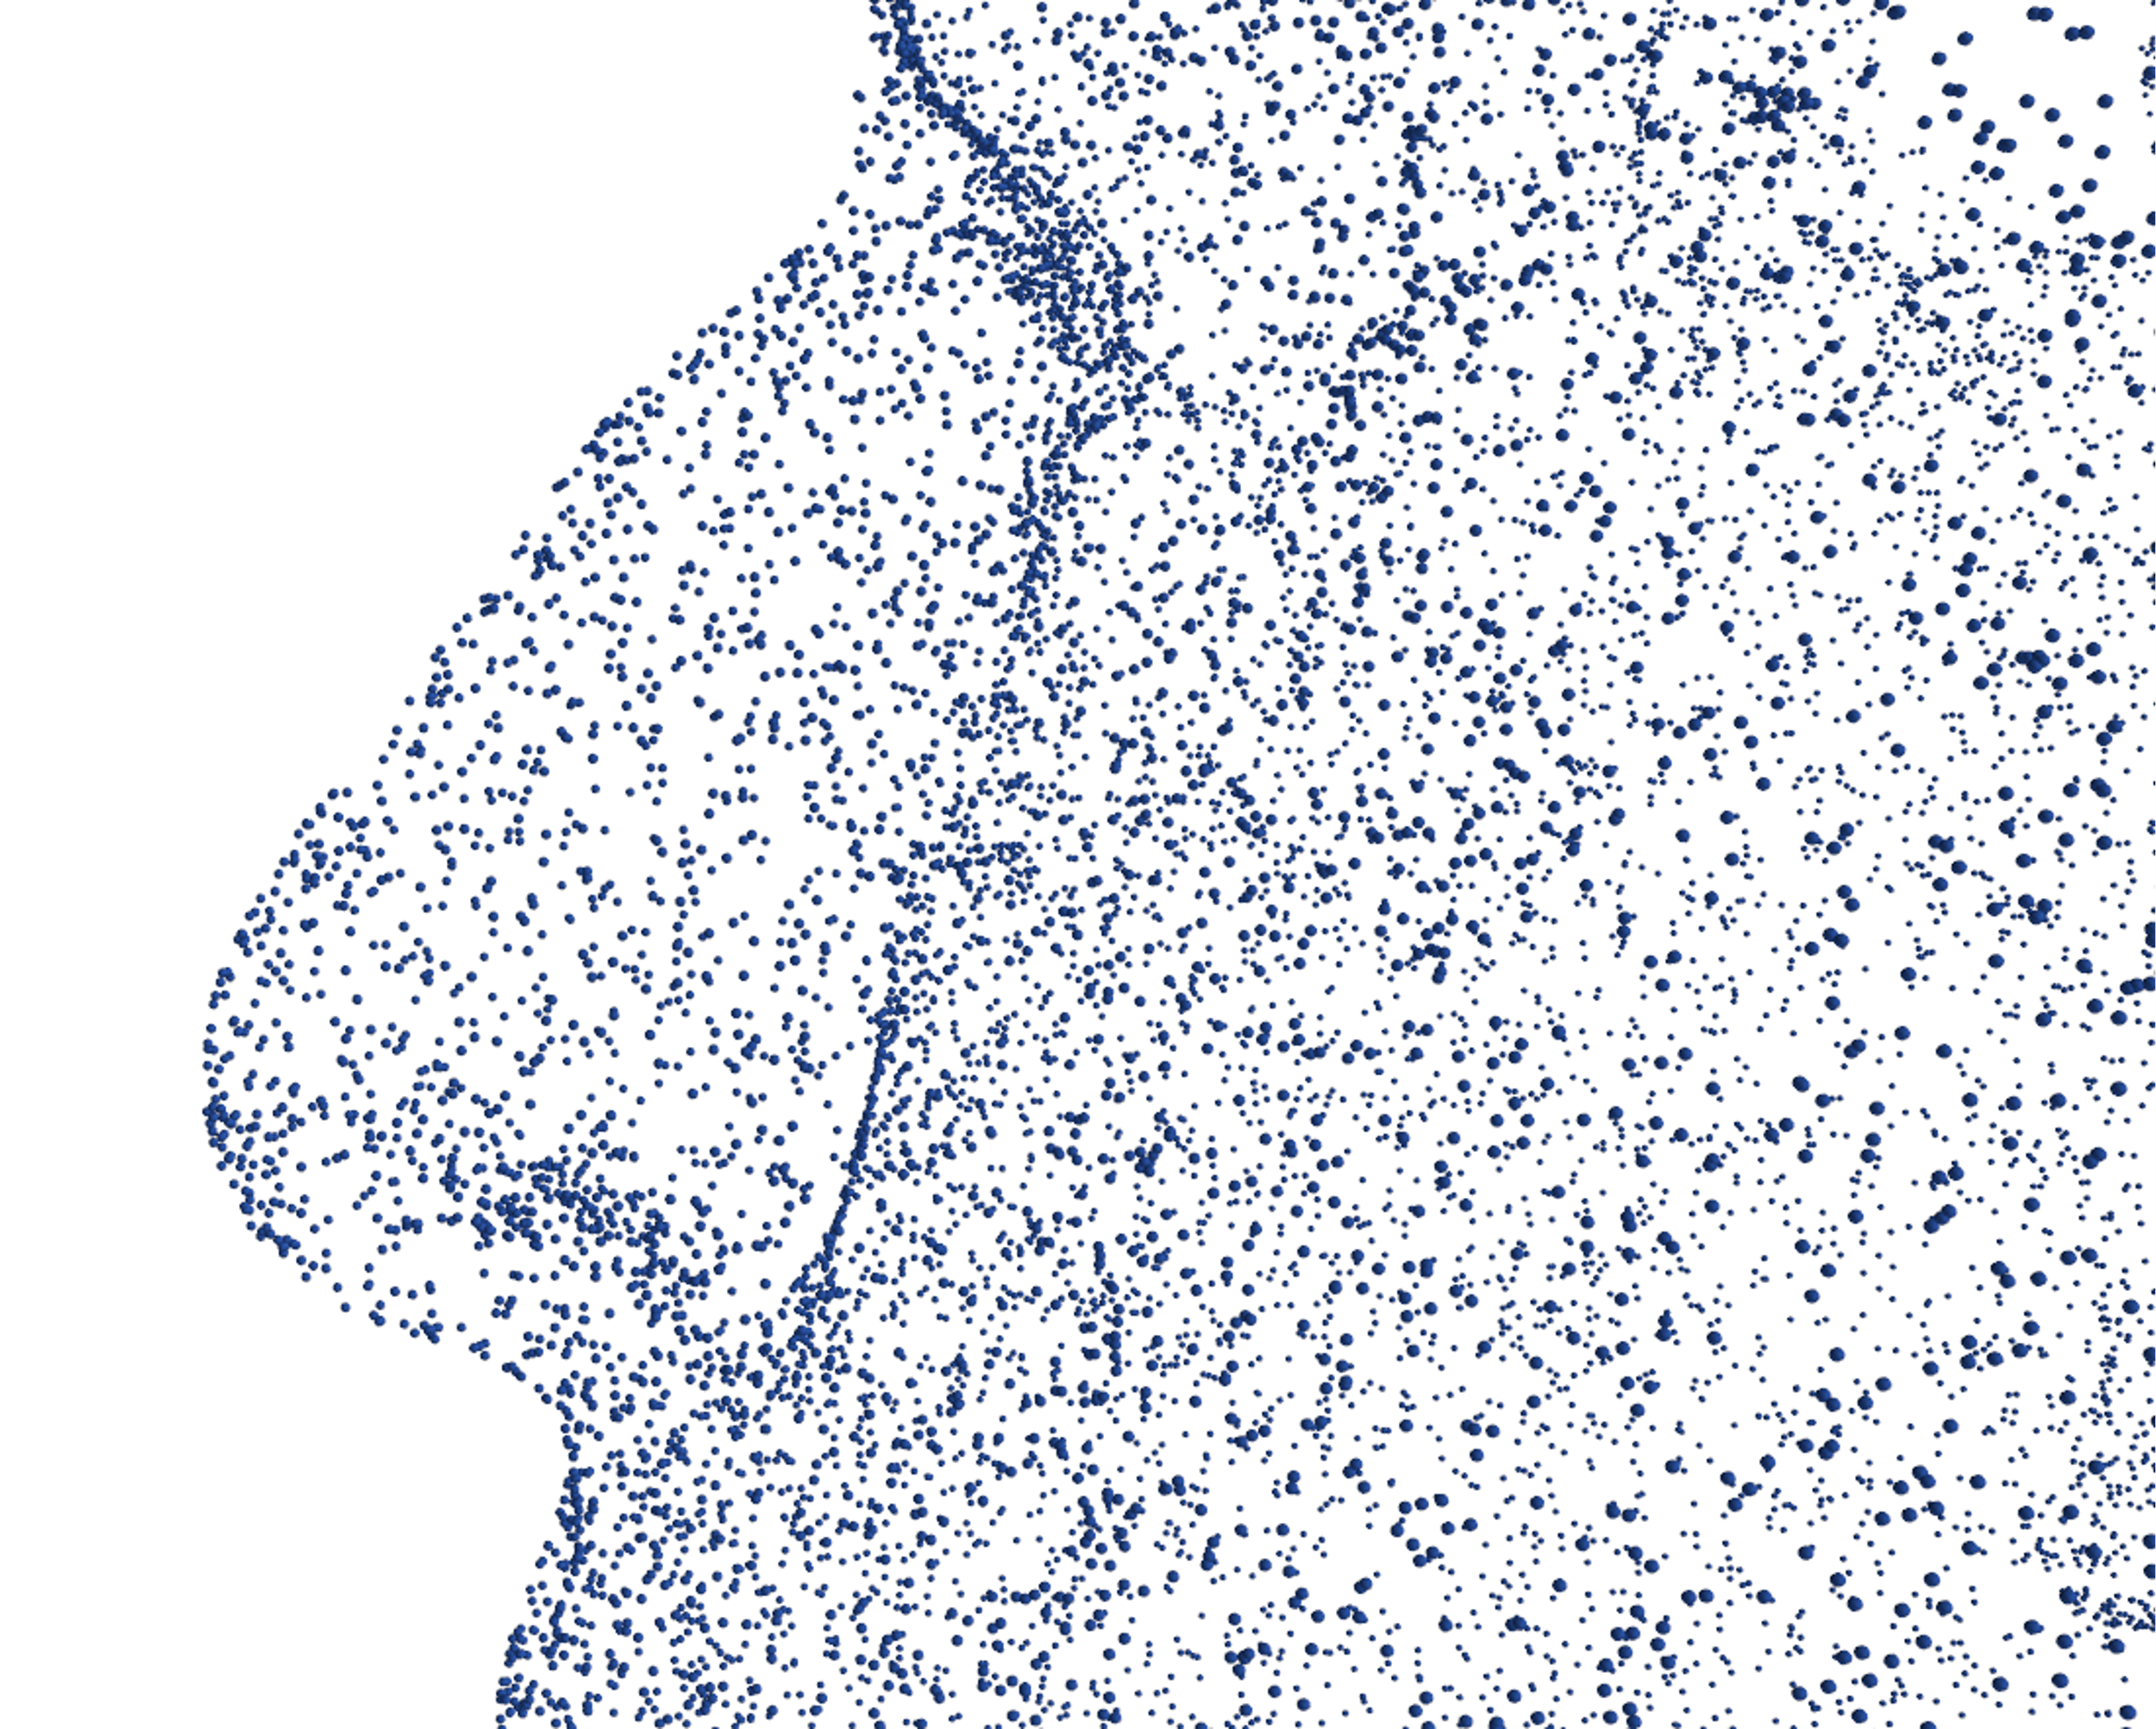

Sorting
Before sorting:
Notes:
Why we sort?

Slide 8

Sorting
Before sorting:
After sorting:
2 proposed method:
Morton Code Sorting
Sorting Based on a Reference point
Notes:
Why we sort?

Slide 9
Models

Slide 10
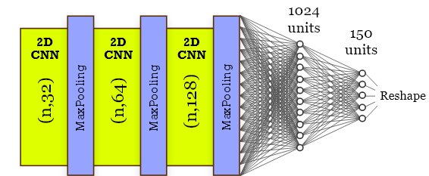
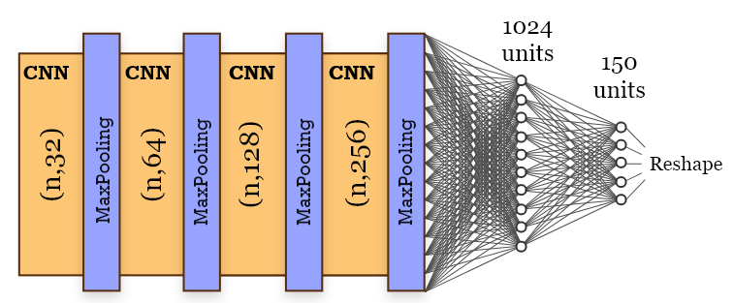
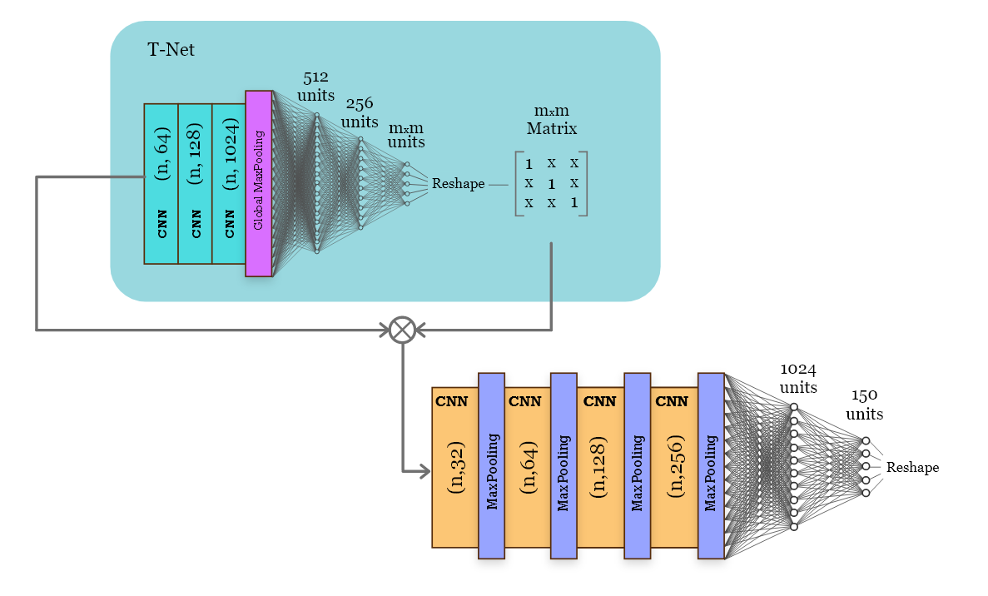
2-step approach
+
Estimation Model
Refinement Model
+
EsTi Model
Refinement Model

Slide 11
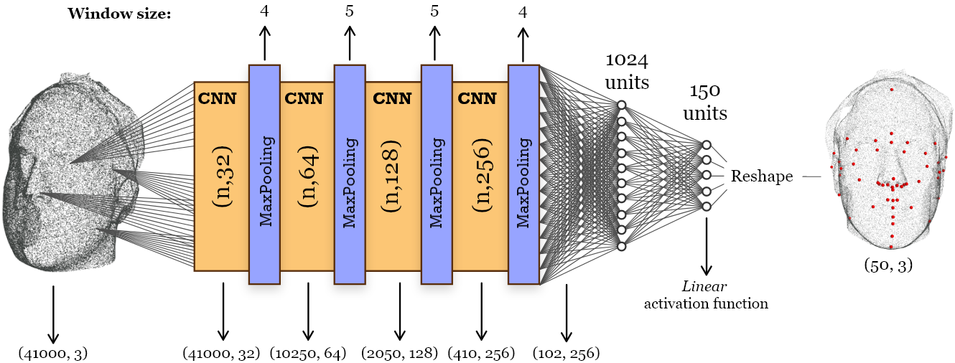
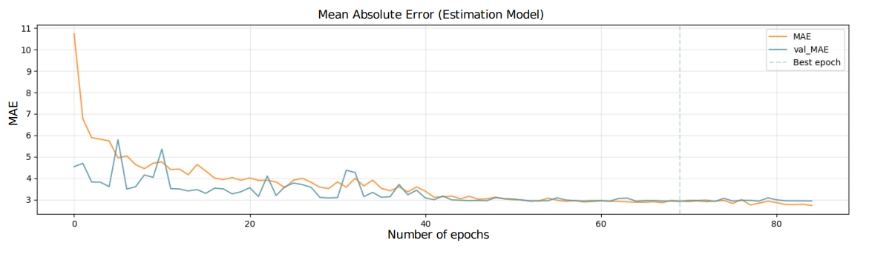
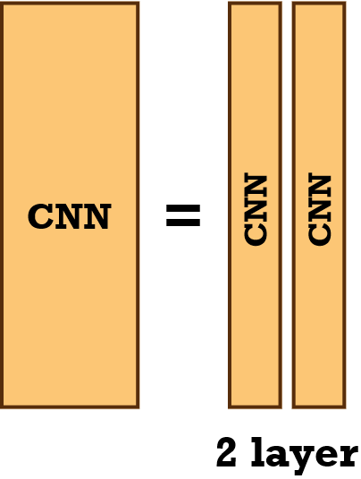
Estimation Stage - Estimation Model (Pointwise CNN)
- INPUT: 2D array (#points, features per point)
- OUTPUT: (50, 3)
- LOSS FUNCTION : Mean Absolute Error (MAE)
- BATCH SIZE : 4
- LEARNING RATE (LR) : 0.001
- CALLBACKS:
- EARLY STOPPING PATIENCE : 15
- REDUCE LR ON PLATEU FACTOR : 10
- NUM. PARAMETERS : 27 millions (103 MB)

Slide 12
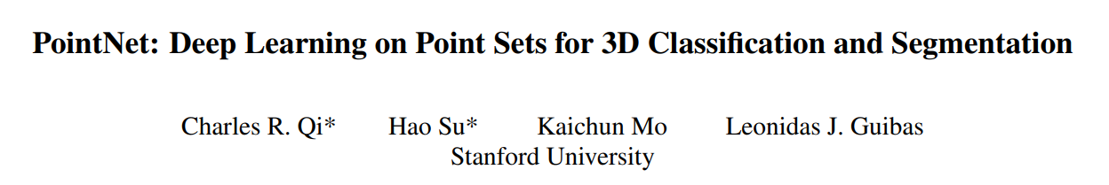
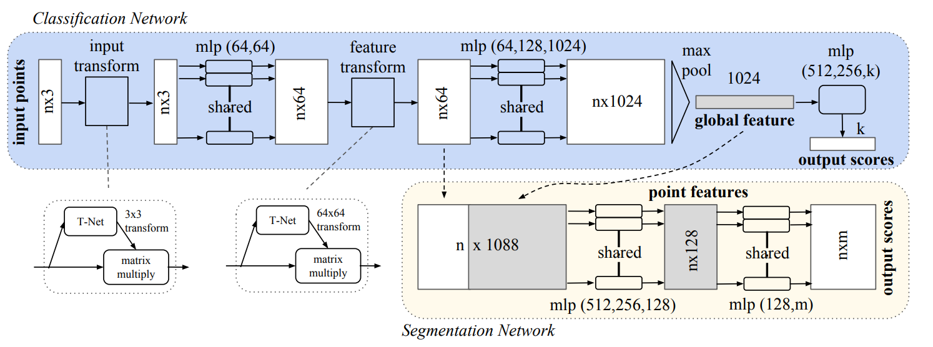
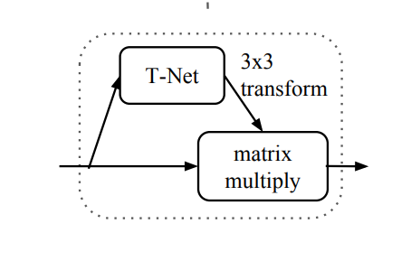
PointNet

Slide 13
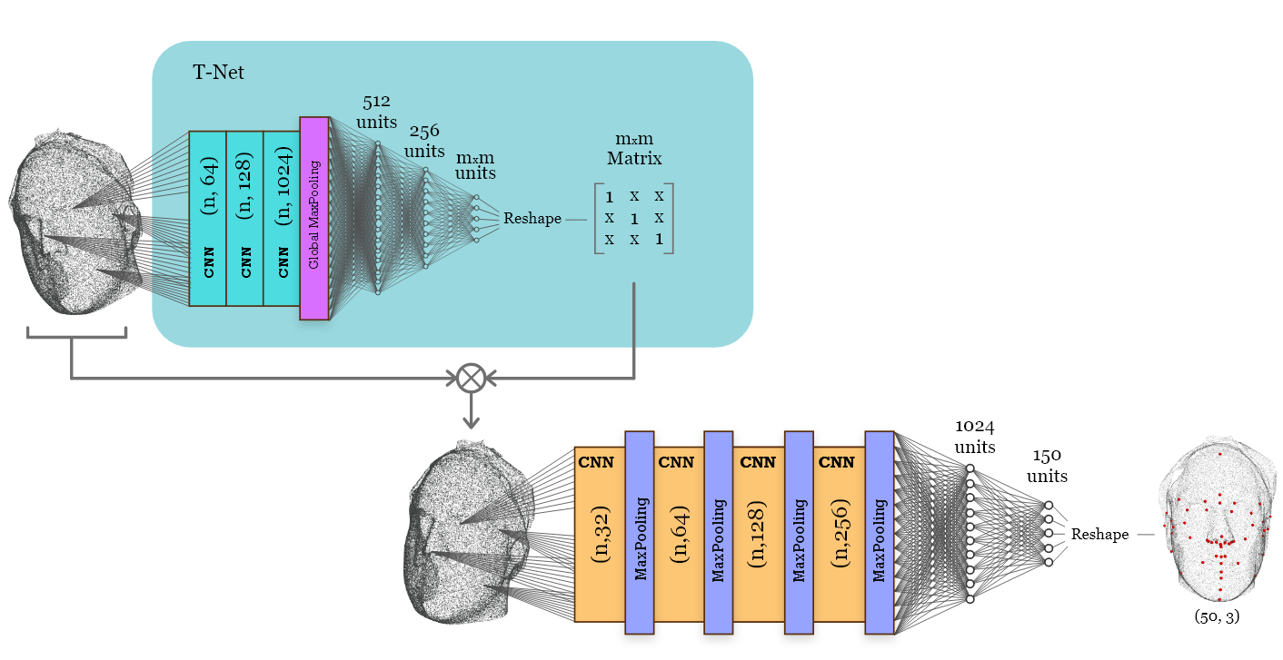
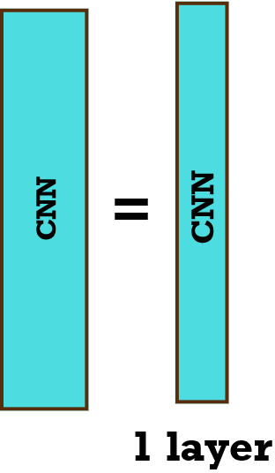
Estimation Stage - EsTi Model
- LOSS FUNCTION : Mean Absolute Error (MAE)
- BATCH SIZE : 4
- LEARNING RATE (LR) : 0.001
- CALLBACKS:
- EARLY STOPPING PATIENCE : 15
- REDUCE LR ON PLATEU FACTOR : 10
- NUM. PARAMETERS : 27 millions (106 MB)
,

Slide 14
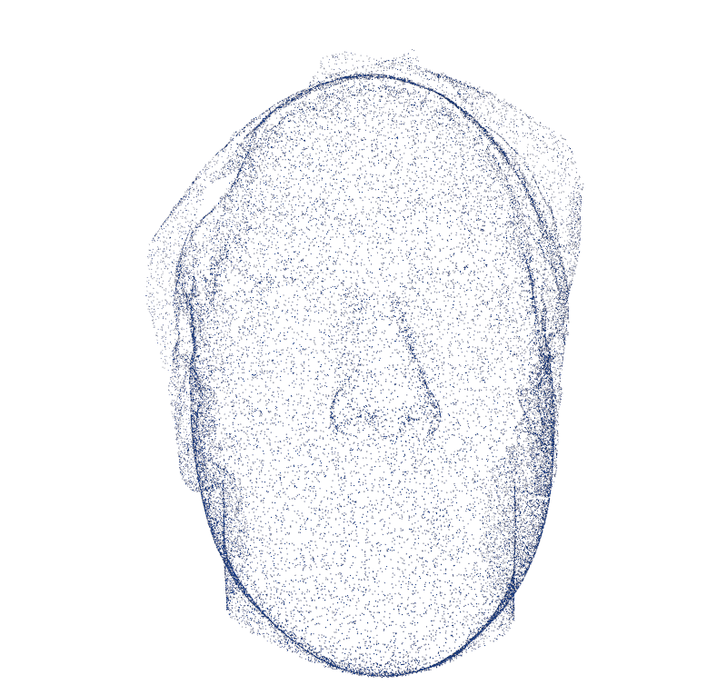
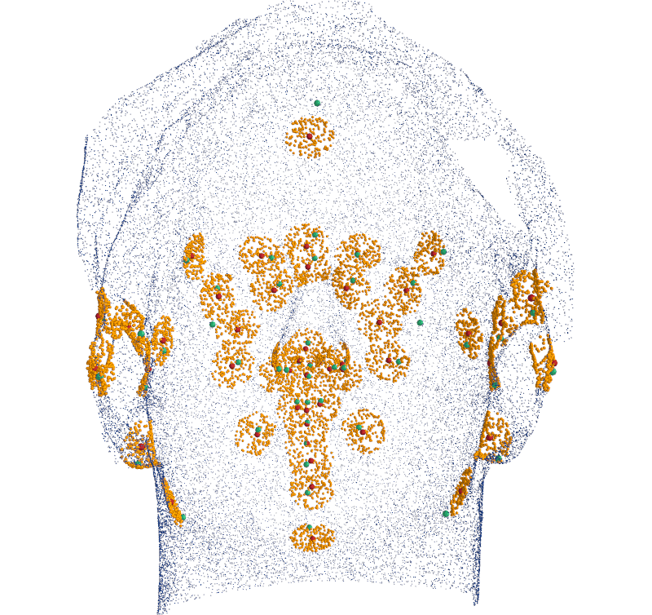
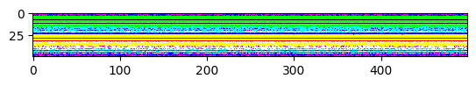
Refinement Preprocessing
In each small point cloud, the ground truth landmark is located somewhere in it.
50 small point clouds, each resampled to 500 vertices resulting in an array shaped :
(200, 50, 500, 3)
Only in the case where we look at point clouds!
Can be viewed as and image!
Predicted landmarks from the Estimation stage
Ground truth landmarks
Points within the radius

Slide 15
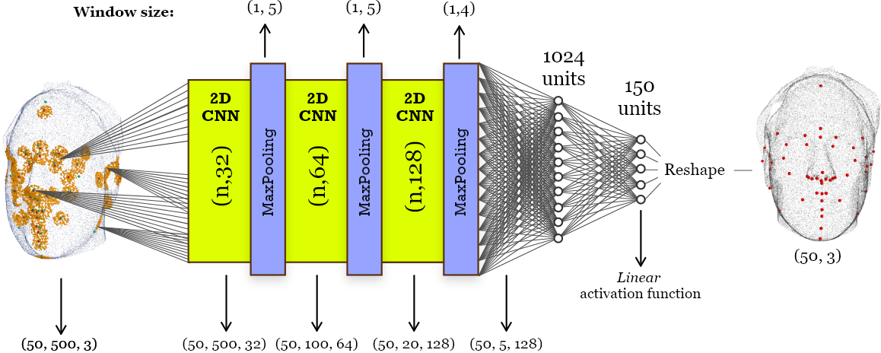
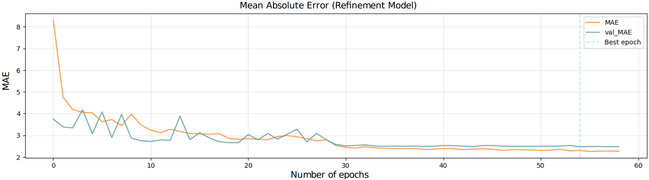
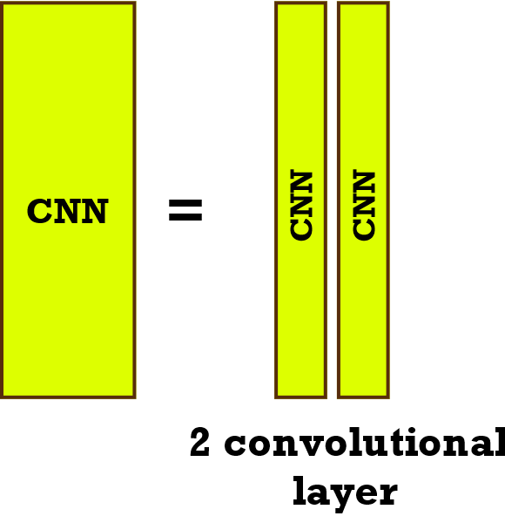
Refinement Model
- INPUT: 3D array (#point clouds, #points, features per point)
- OUTPUT: (50, 3)
- LOSS FUNCTION : Mean Absolute Error (MAE)
- BATCH SIZE : 4
- LEARNING RATE (LR) : 0.001
- CALLBACKS:
- EARLY STOPPING PATIENCE : 15
- REDUCE LR ON PLATEU FACTOR : 10
- NUM. PARAMETERS : 33 millions (125 MB)

Slide 16
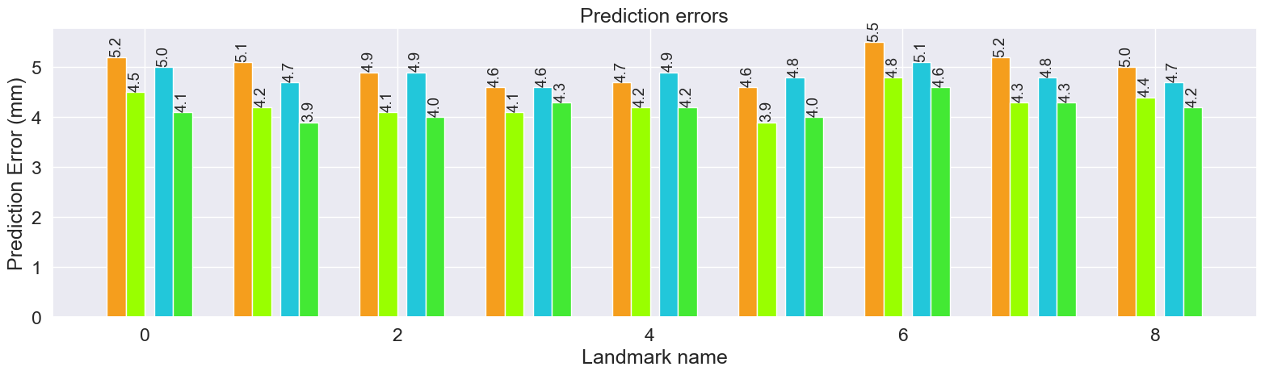
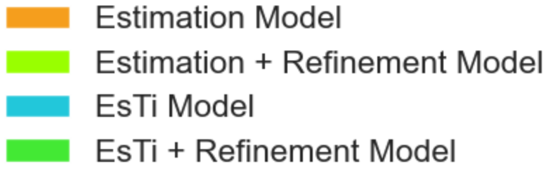
Results and Discussion
Baseline
(Morton code sorting)
Baseline
(Sorting based on the
origin of the reference
system)
Baseline
(Sorting based on a
point above the
forehead)
With Vector Normals
Data Augmentation
Rigid
Data Augmentation
Non-rigid
Re-sample
10,000 vertices
Re-sample
20,000 vertices
Re-sample
30,000 vertices
$$Euclidean distance= \sqrt{{\left(x_{Pred}− x_{GT}\right)}^{2}+{\left(y_{Predicted}− y_{GT}\right)}^{2}+{\left(z_{Predicted}−z_{GT}\right)}^{2}}$$

Slide 17
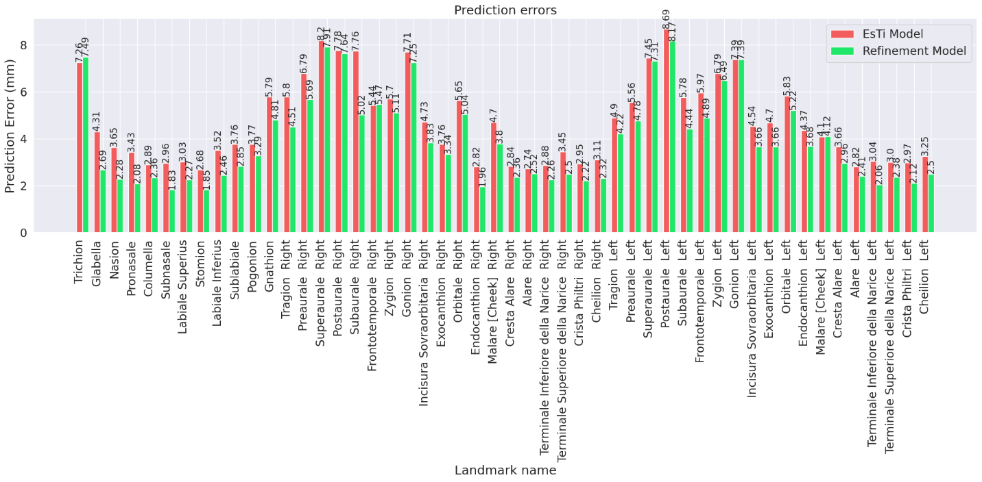
Results and Discussion

Slide 18
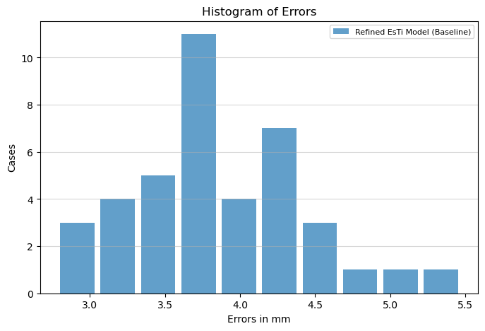
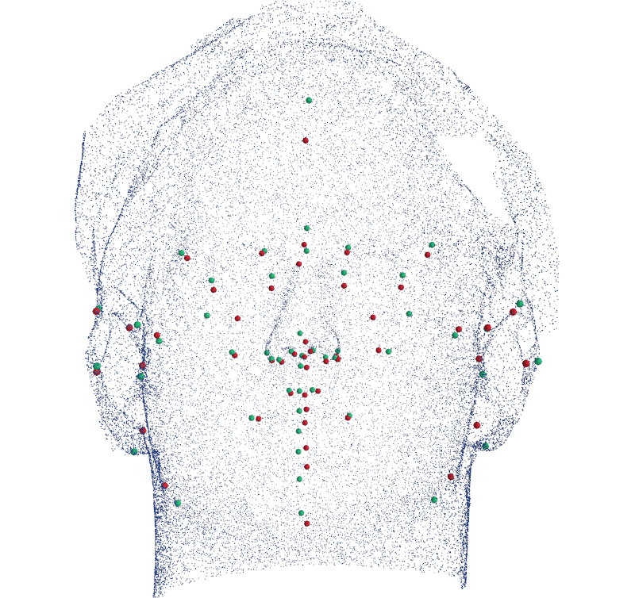
Conclusions and Future works
Best Model | Adjusted MED-test
Baseline – sorting based on origin (EsTi + Refined Model) | 3.54mm
Future works:
More effective registration and cropping process
Consider RGB values (texture) as features
Graph Convolutional Neural Networks (GCNNs)
Test on other datasets for comparability such as BU-3DFE
Predicted landmarks
Ground truth landmarks

Slide 19
🎓
🧑
Thank you!
🙏

Slide 20

APPENDIX

Slide 21

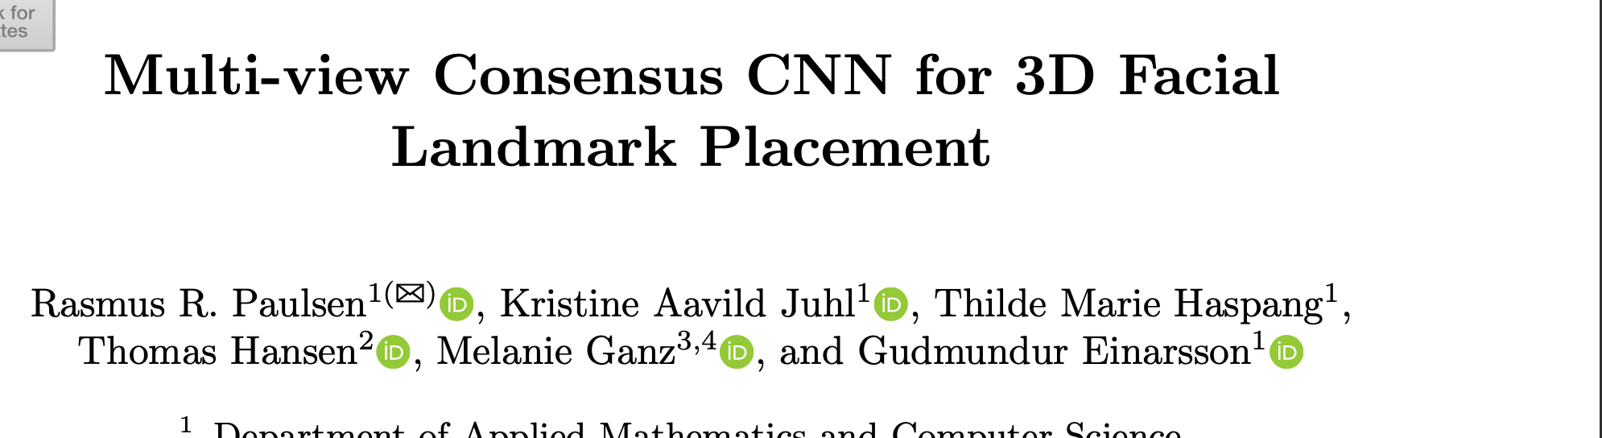
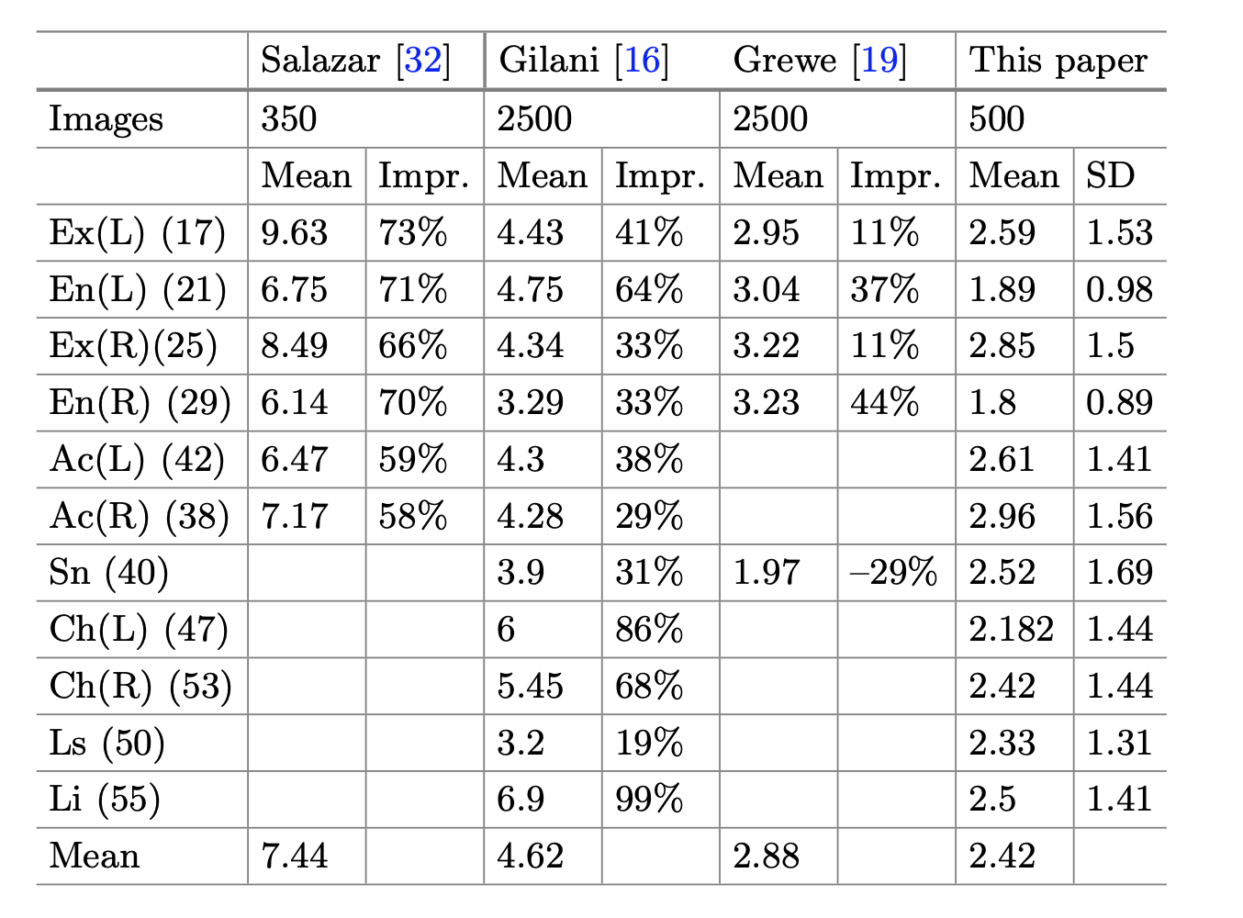
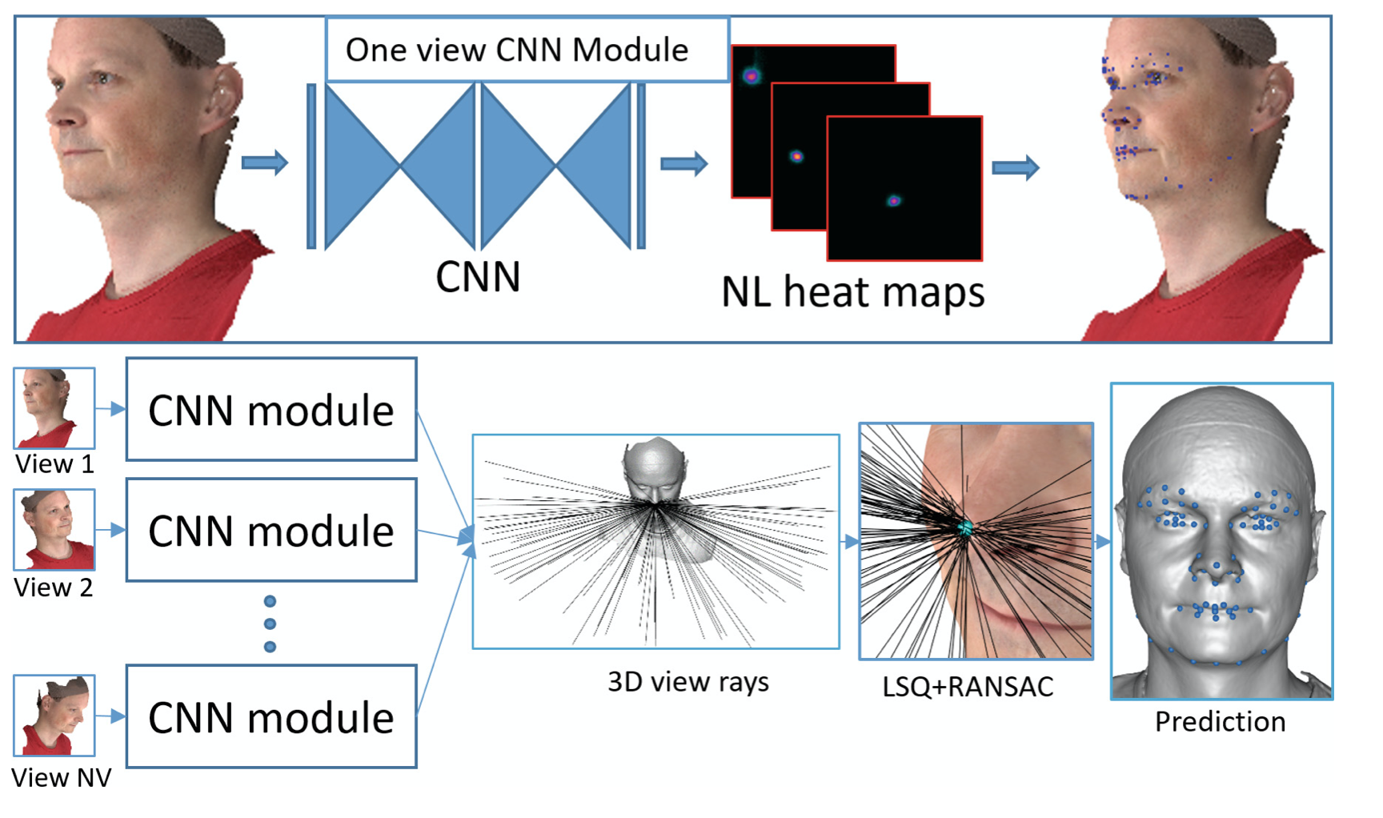
State of the Art (Deep learning)

Slide 22
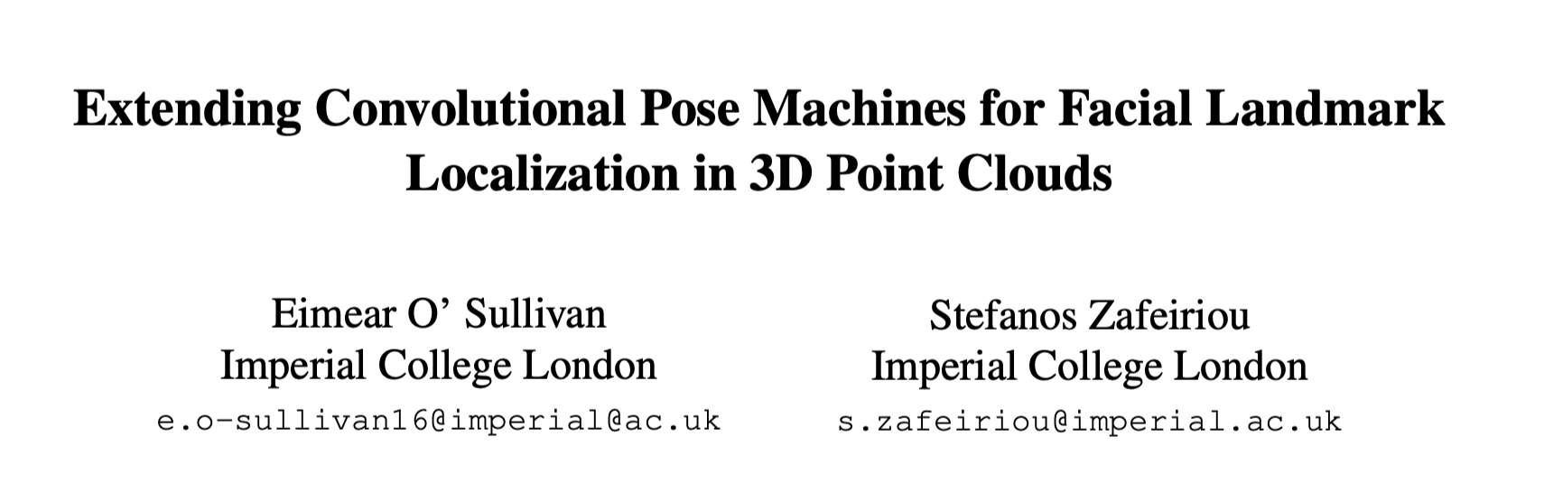
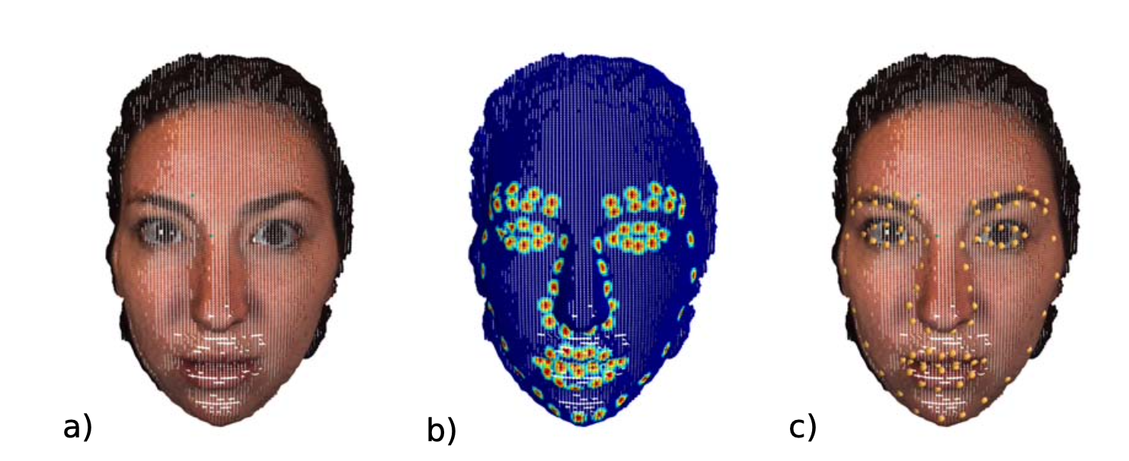
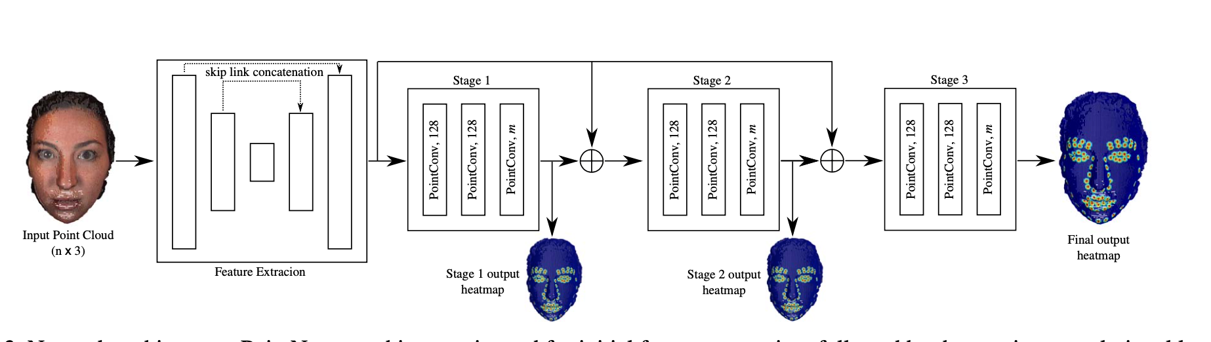
State of the Art (Deep learning)

Slide 23
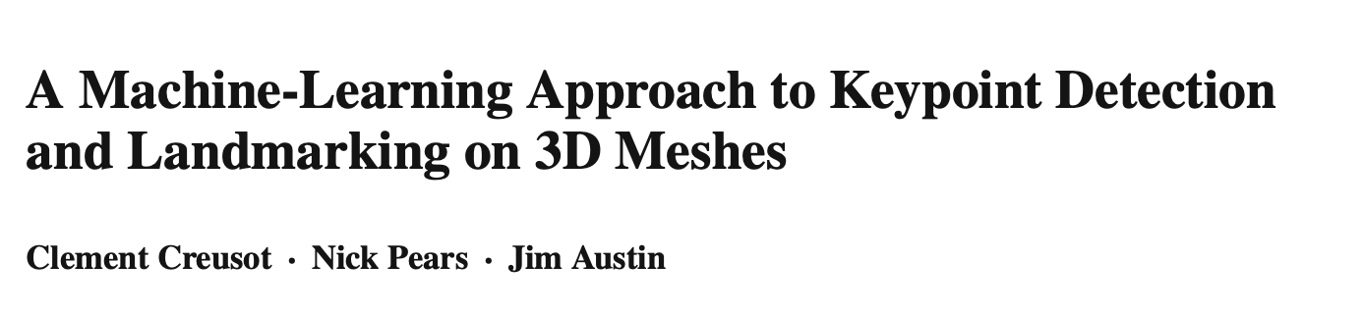
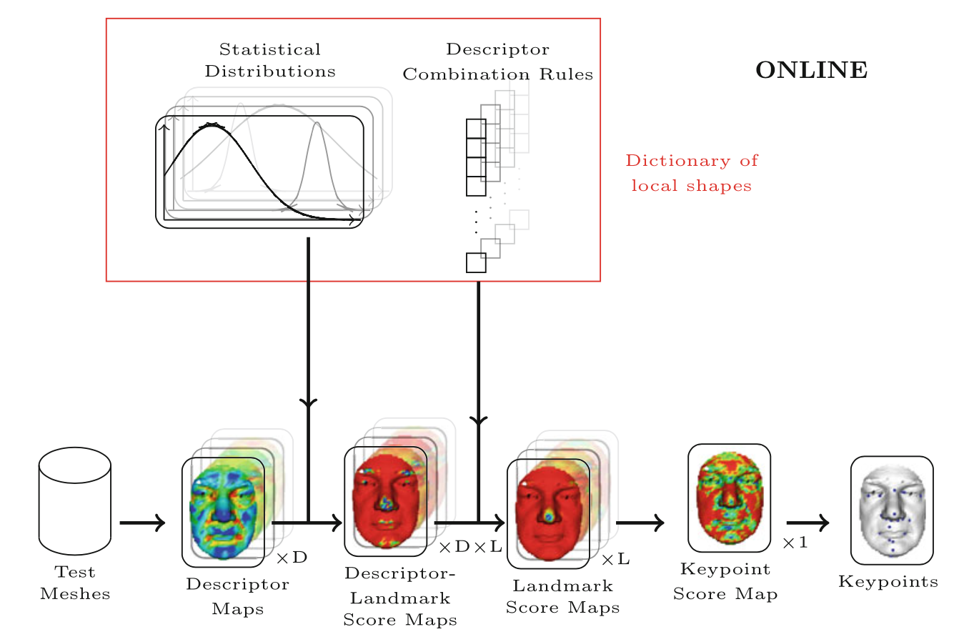
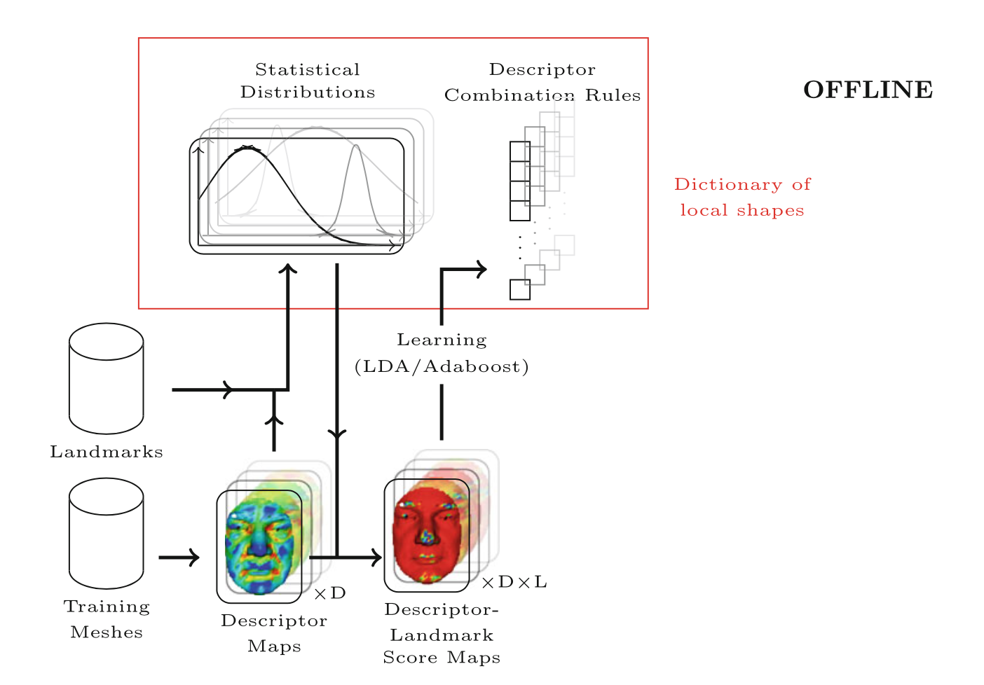
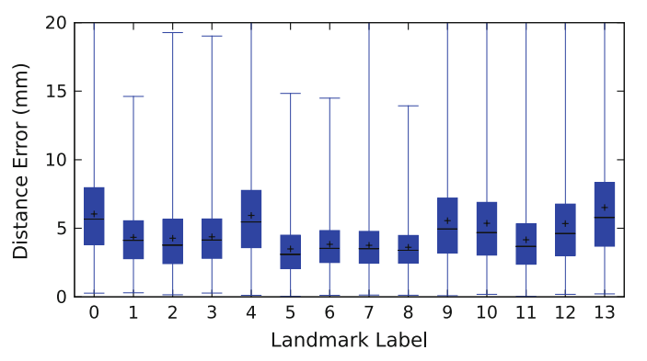
State of the Art (Machine learning)
~5mm error

Slide 24
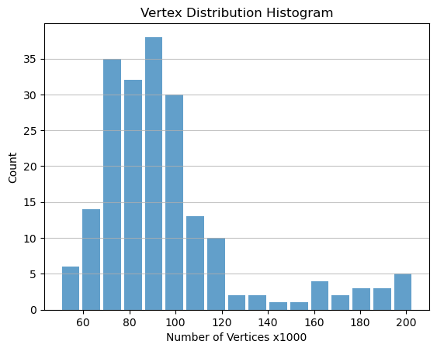
Our Dataset
200 stereophotographs with annotated facial landmarks:
Input data (200, N, 3) (OBJ file)
Maximum of ~200,000 point (vertexes)
3 value for each point (XYZ coordinates)
3 value for vector normals (nx,ny,nz)
2-3 jpeg images per face
Target data: (200, 50, 3)
201 facial models
50 landmarks
3 value for each point (XYZ coordinates)

Slide 25

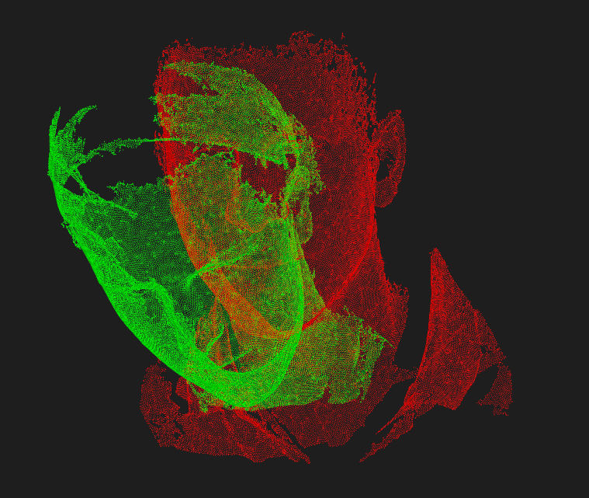
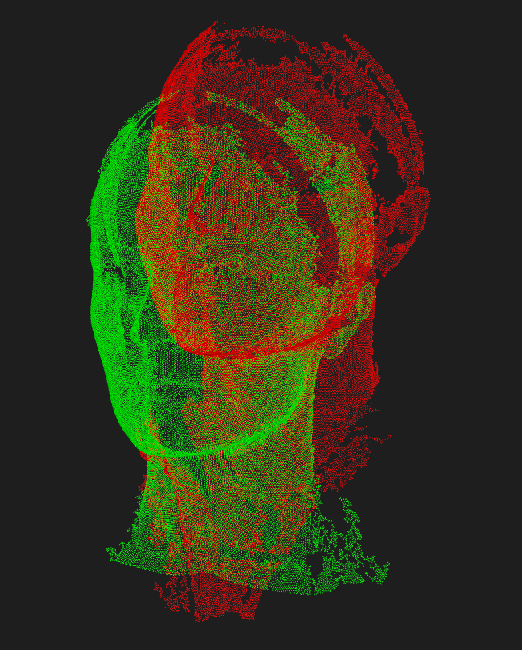
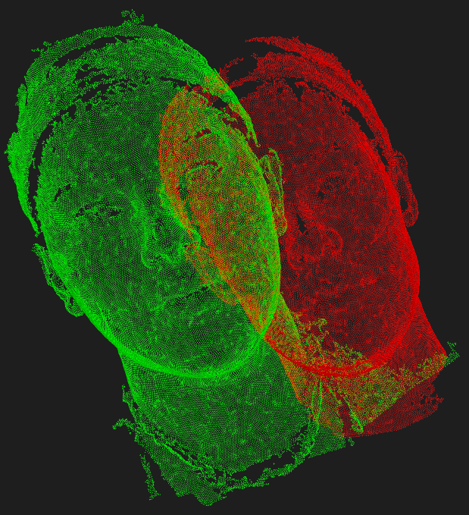
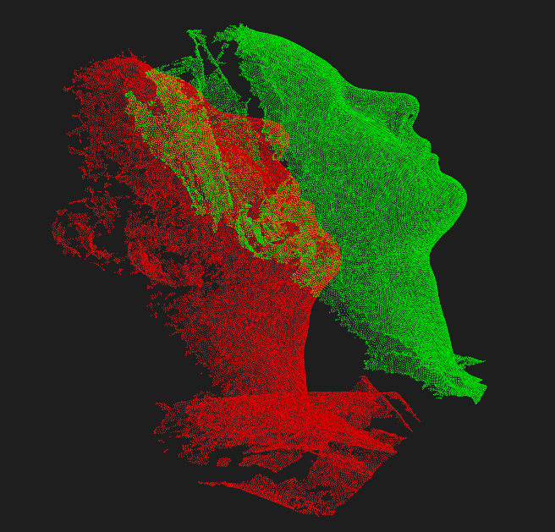
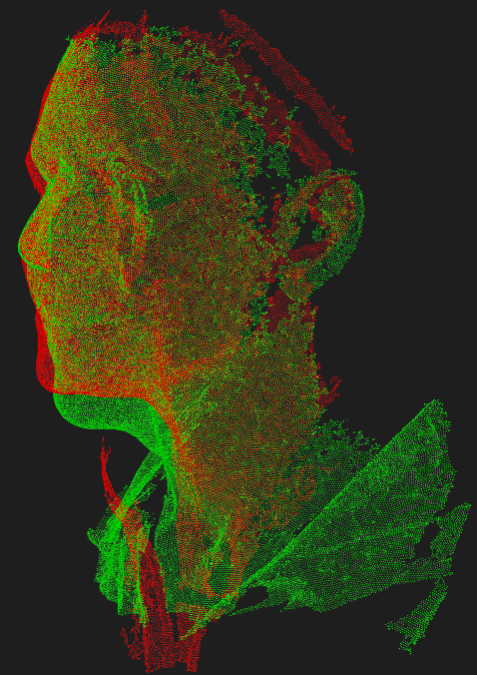
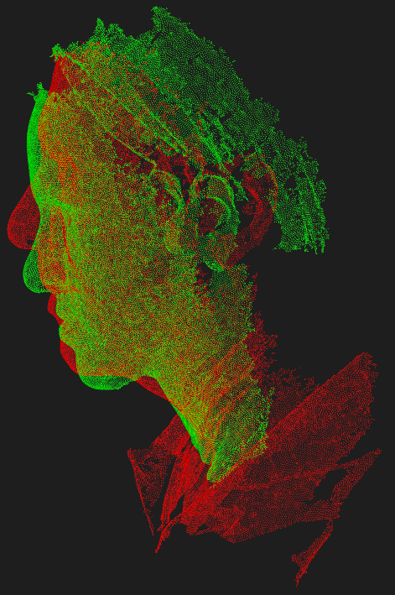
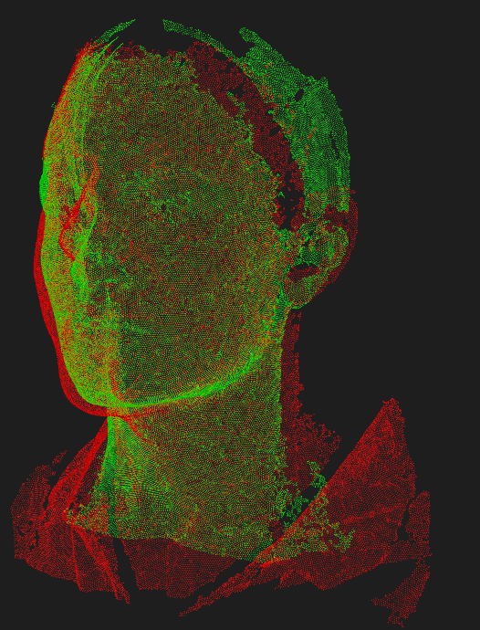
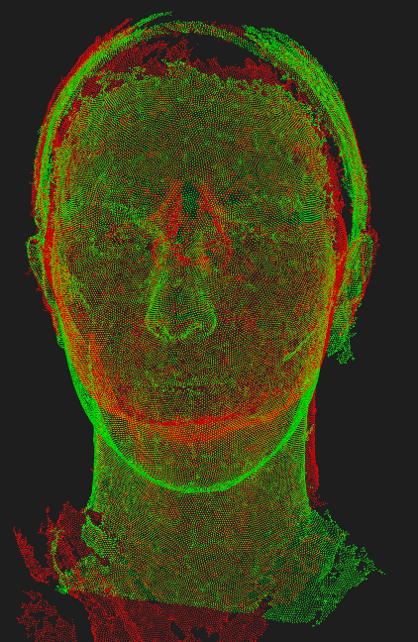
Iterative Closest point (ICP) registration algorithm

Slide 26

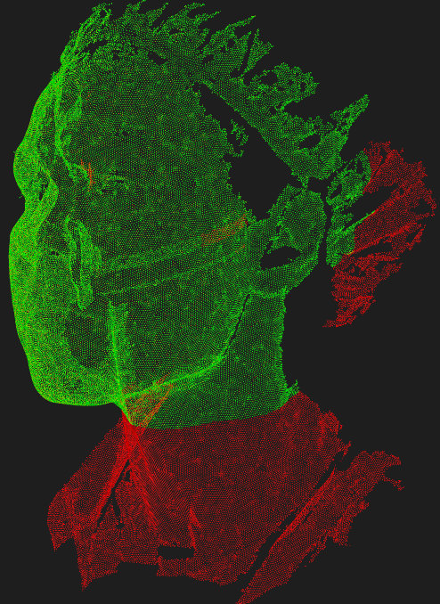


Framing (cropping)

Slide 27



Framing (cropping)

Slide 28




Re-sampling
Baseline
(41000)
30,000
20,000
10,000

Slide 29






Data Augmentation
Rigid
Non-rigid
Rotation
Scaling
Stretching factor
Translation

Slide 30
Sorting
Morton Code Sorting
Sorting Based on a Reference point
Let us consider a point with coordinates (X=4, Y=2, Z=6)
1. Convert to Binary:
(X= 100, Y=010, Z=110)
2. Interleave Bits:
This is usually done by taking alternate bits from each coordinate.
Interleaved bits = 101110000
3. Convert to Decimal:
Morton code = 368
4. Sorting:
Sort the points based on their Morton code
Based on the origin of the reference system
Based on a point above the forehead
Barycenter of the face (head)
Notes:
Why we sort?

Slide 31

Proposed Model

Slide 32


Estimation stage
EsTi model (Minimizing Mean Absolute Error)

Slide 33

Results and Discussion

Slide 34



Model selection
Localization Error
Mean Residual Standard Deviation

Slide 35

Visualization

Slide 36

Results and Discussion
Estimation Model
Refinement Model
After post processing

